Slide 1

ANALYSIS OF THE STACK OVERFLOW DEVELOPER SURVEY DATA (2024)
Luis Guerrero
September 16, 2025

Slide 2



OUTLINE
Executive Summary
Introduction
Methodology
Results
Visualization – Charts
Dashboard
Discussion
Findings & Implications
Conclusion
Appendix

Slide 3

EXECUTIVE SUMMARY
Objective:
To identify the most used technologies by developers and those they aspire to use, considering age, country, and education.
Methodologies:
Data Collection, Data Wrangling, Exploratory Data Analysis, Visualizations, and Dashboard.
Key Findings:
HTML/CSS, JavaScript, TypeScript, and C# lead current technology usage.
PostgreSQL is the most adopted and most desired database.
AWS dominates cloud platform usage, with Azure showing strong future interest.
Majority of respondents are 25–34 years old with Bachelor’s/Master’s degrees.
Majority of respondents are from the USA.

Slide 4

INTRODUCTION
The Stack Overflow Developer Survey is one of the largest annual surveys of developers worldwide.
It provides insights into technologies currently used, tools developers want to adopt, and demographic trends in the developer community.
This project explores the dataset to understand:
Which programming languages, databases, and platforms are most popular today.
What technologies developers aspire to work with in the future.
How usage patterns vary by age, country, and education level.
Approximately 65,000+ respondents.

Slide 5

METHODOLOGY
Data Collection
APIs
Web Scraping
Data Wrangling (Cleaning)
Finding and Removing Duplicates
Finding and Imputing Missing Values
Normalizing Data
Exploratory Data Analysis (EDA)
Analyzing Data Distribution
Finding Outliers
Finding Correlations
Data Visualization with Python & SQL
Data Distribution
Relationships
Data Composition
Data Comparison
Interactive Dashboard
IBM Cognos Analytics

Slide 6


RESULTS

Slide 7
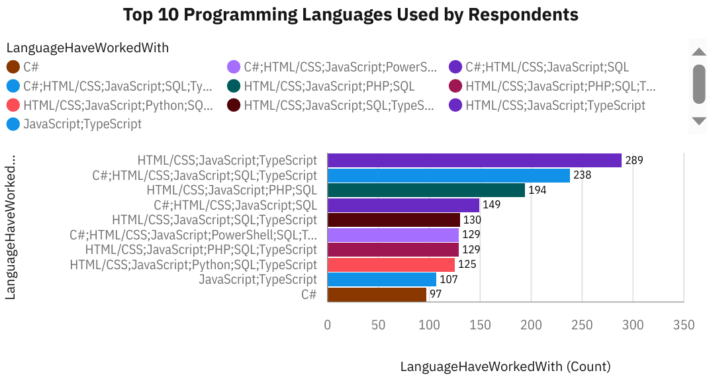
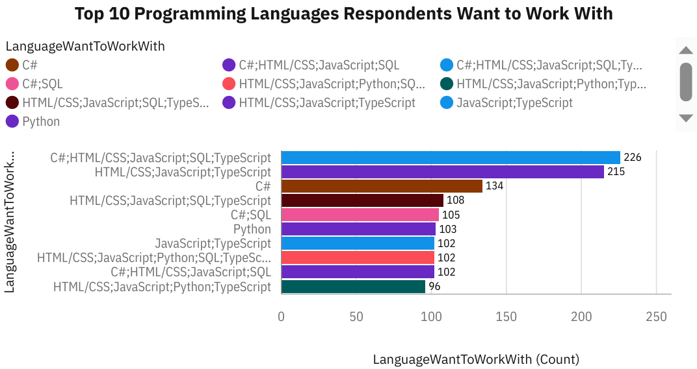
PROGRAMMING LANGUAGE TRENDS
Current Year
Next Year

Slide 8
PROGRAMMING LANGUAGE TRENDS - FINDINGS & IMPLICATIONS
Findings
Most used languages: HTML/CSS, JavaScript, TypeScript, and C# lead adoption.
Developers often combine multiple core languages, such as HTML/CSS + JavaScript + SQL.
High future interest in JavaScript, TypeScript, and C# (also being these the most currently used)
Python and SQL remain highly desired, showing steady long-term relevance.
Implications
Learning HTML/CSS, JavaScript, TypeScript, Python, and C# will remain highly valuable for both present and future job opportunities.
The demand will continue for talent skilled in web development stacks, data related programming (Python, SQL), and enterprise languages (C#).
Curriculum should emphasize full-stack JavaScript, Python for data & AI, and C# for enterprise and cloud applications.

Slide 9
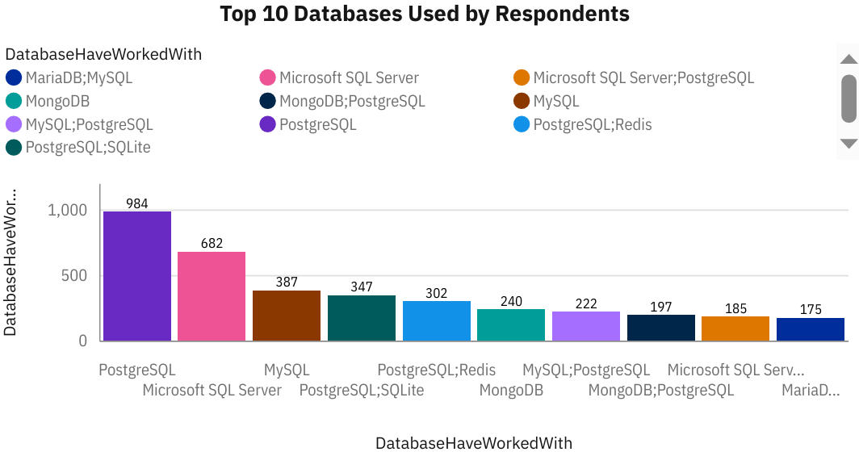
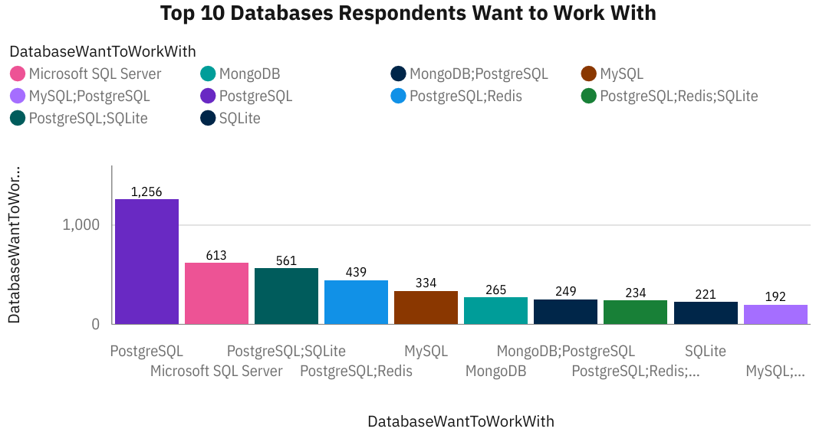
DATABASE TRENDS
Current Year
Next Year

Slide 10
DATABASE TRENDS - FINDINGS & IMPLICATIONS
Findings
PostgreSQL is the most widely used database and the most desired for future use, showing both high adoption and high demand.
Microsoft SQL Server and MySQL continues to be relevant, but their growth aspiration is lower than PostgreSQL.
MongoDB (non-relational database) is increasingly attractive to developers, and its adoption is moderate, while other databases like SQLite and MariaDB have smaller user bases.
SQLite is also gaining attention.
Implications
Skills in PostgreSQL are highly valuable, with strong demand today and into the future.
PostgreSQL dominance indicates a shift toward open-source and cost-effective databases over traditional proprietary systems.
Curriculum should balance SQL fundamentals (PostgreSQL, Microsoft SQL Server, MySQL) with exposure to NoSQL technologies (MongoDB) to prepare developers for diverse roles. Also, exploring options like SQLite can provide an edge.

Slide 11

DASHBOARD
https://github.com/Luiimii/IBM-Data-Analyst-Capstone-Project/blob/main/Survey%20Data%20-%20Dashboard.pdf

Slide 12
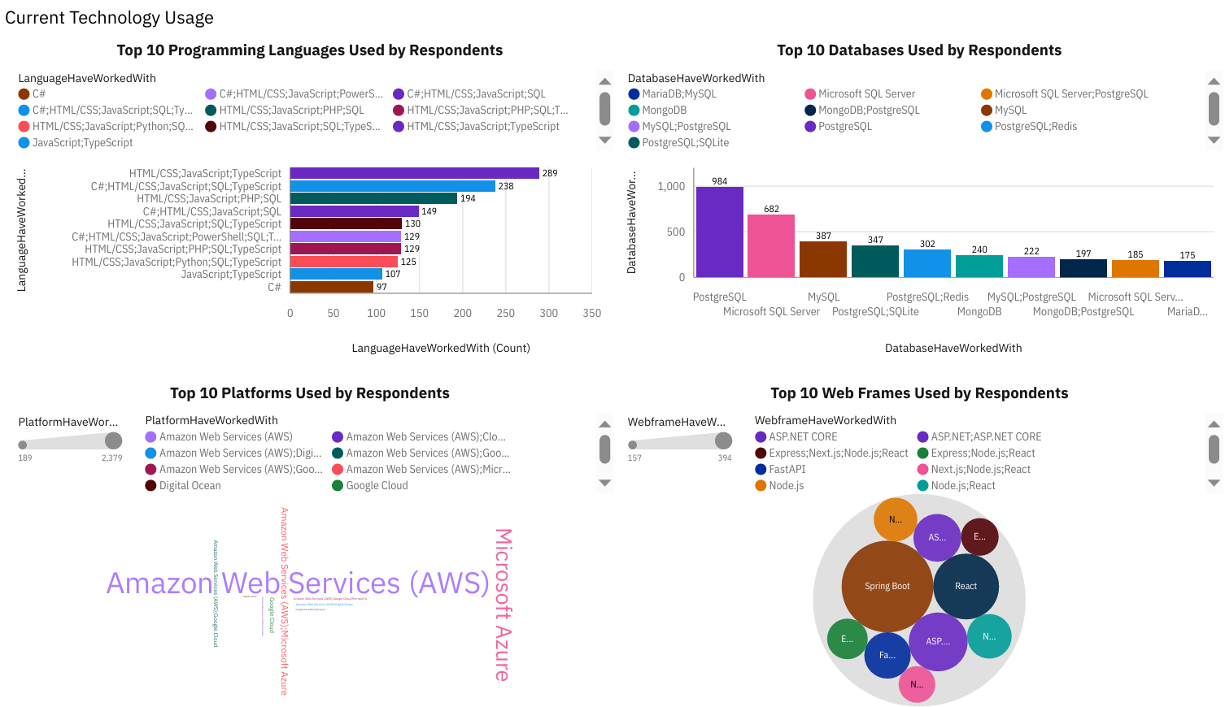
DASHBOARD TAB 1

Slide 13
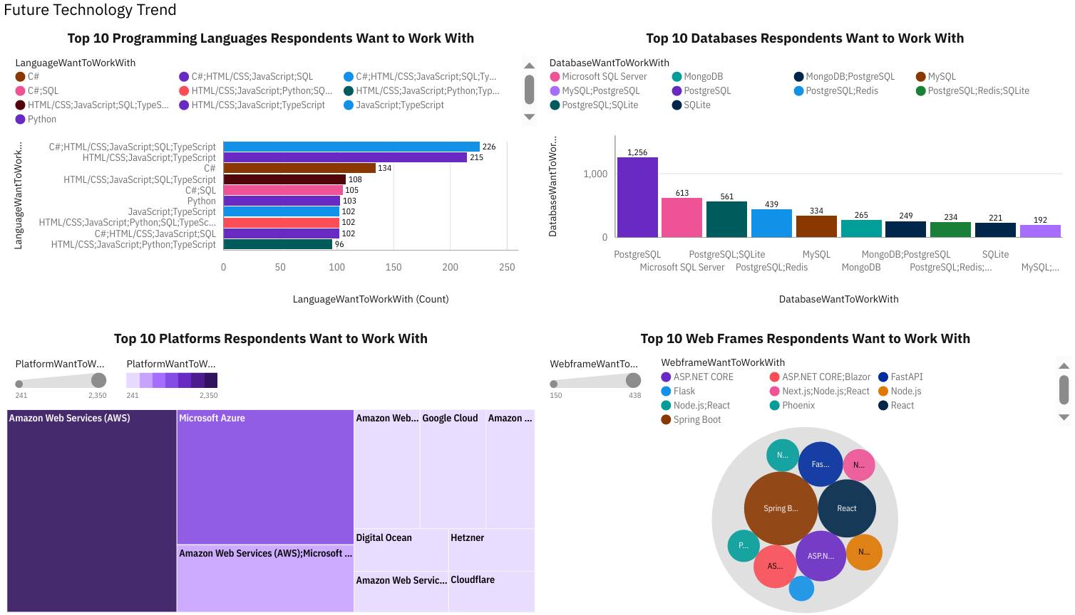
DASHBOARD TAB 2

Slide 14
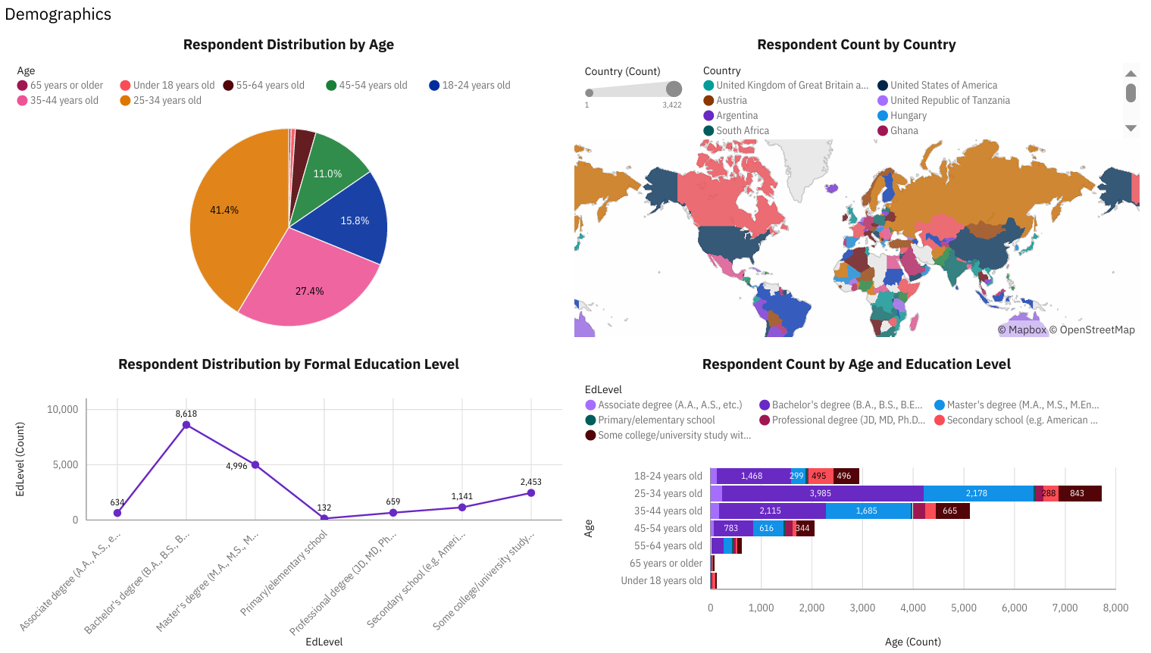
DASHBOARD TAB 3

Slide 15
DISCUSSION
Core languages (JS, Python, C#, etc.) remain dominant, showing stability in developer toolsets.
PostgreSQL growth highlights a shift toward open-source, cloud-friendly databases.
Future aspirations align with current use, suggesting consolidation around key technologies.
Findings connect developer demographics with technology trends, addressing gaps in understanding adoption patterns.

Slide 16
OVERALL FINDINGS & IMPLICATIONS
Findings
HTML, JavaScript, Python, TypeScript, and C# dominate usage and remain highly desired.
PostgreSQL and MongoDB show strong momentum, indicating a shift toward modern, open-source databases.
Developer’s future preferences align with current leading tools, suggesting long-term adoption patterns.
Demographics (age, education, country) influence technology choices, shaping global development trends.
Implications
Organizations and educators should prioritize training and resources in these key technologies to stay aligned with developer demand.

Slide 17

CONCLUSION
The survey reveals clear preferences for core languages and databases that dominate current development.
PostgreSQL rise demonstrates the growing importance of open-source and scalable solutions.
Developer’s future aspirations mirror current leaders, confirming stability in tech adoption.
Demographics shape choices, offering valuable insights for industry and education.
Overall, the analysis provides a data-driven snapshot of today’s developer landscape and its future direction.

Slide 18
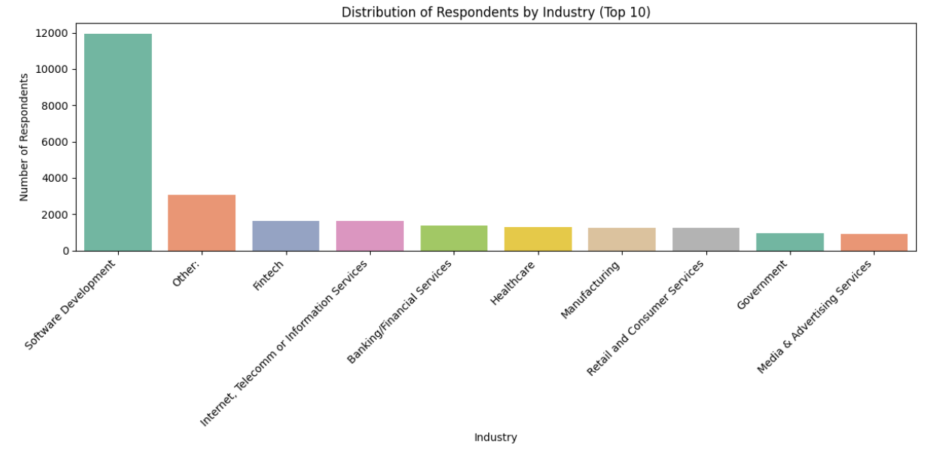
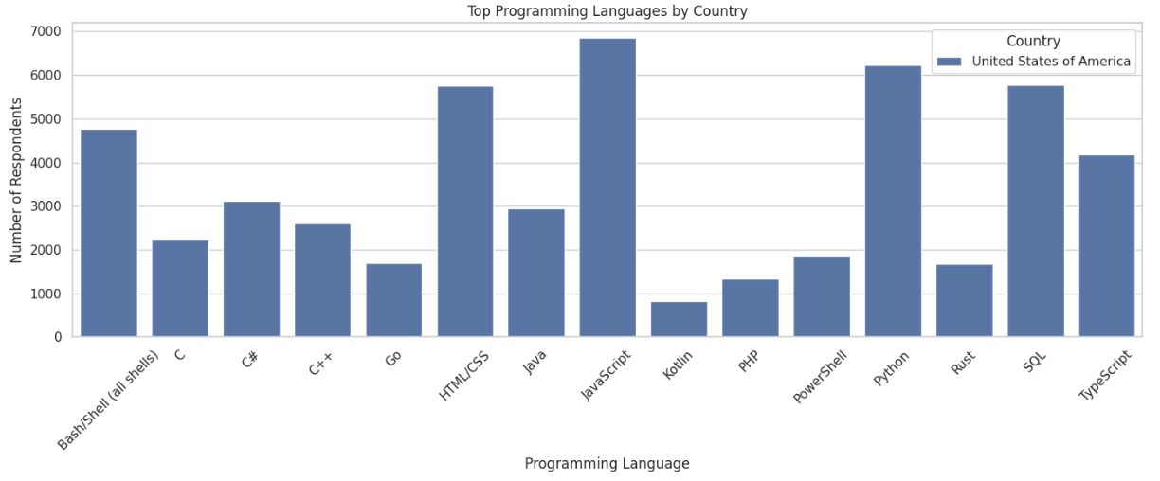
APPENDIX

Slide 19
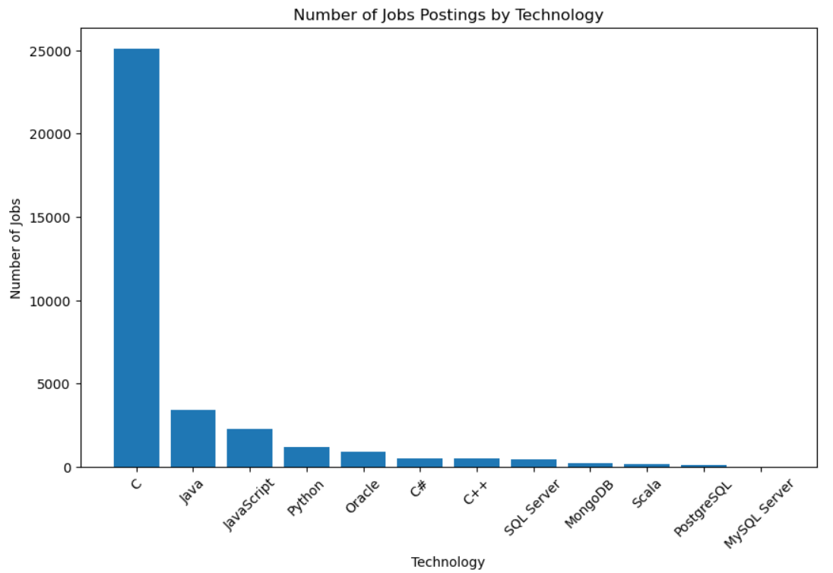
JOB POSTINGS

Slide 20
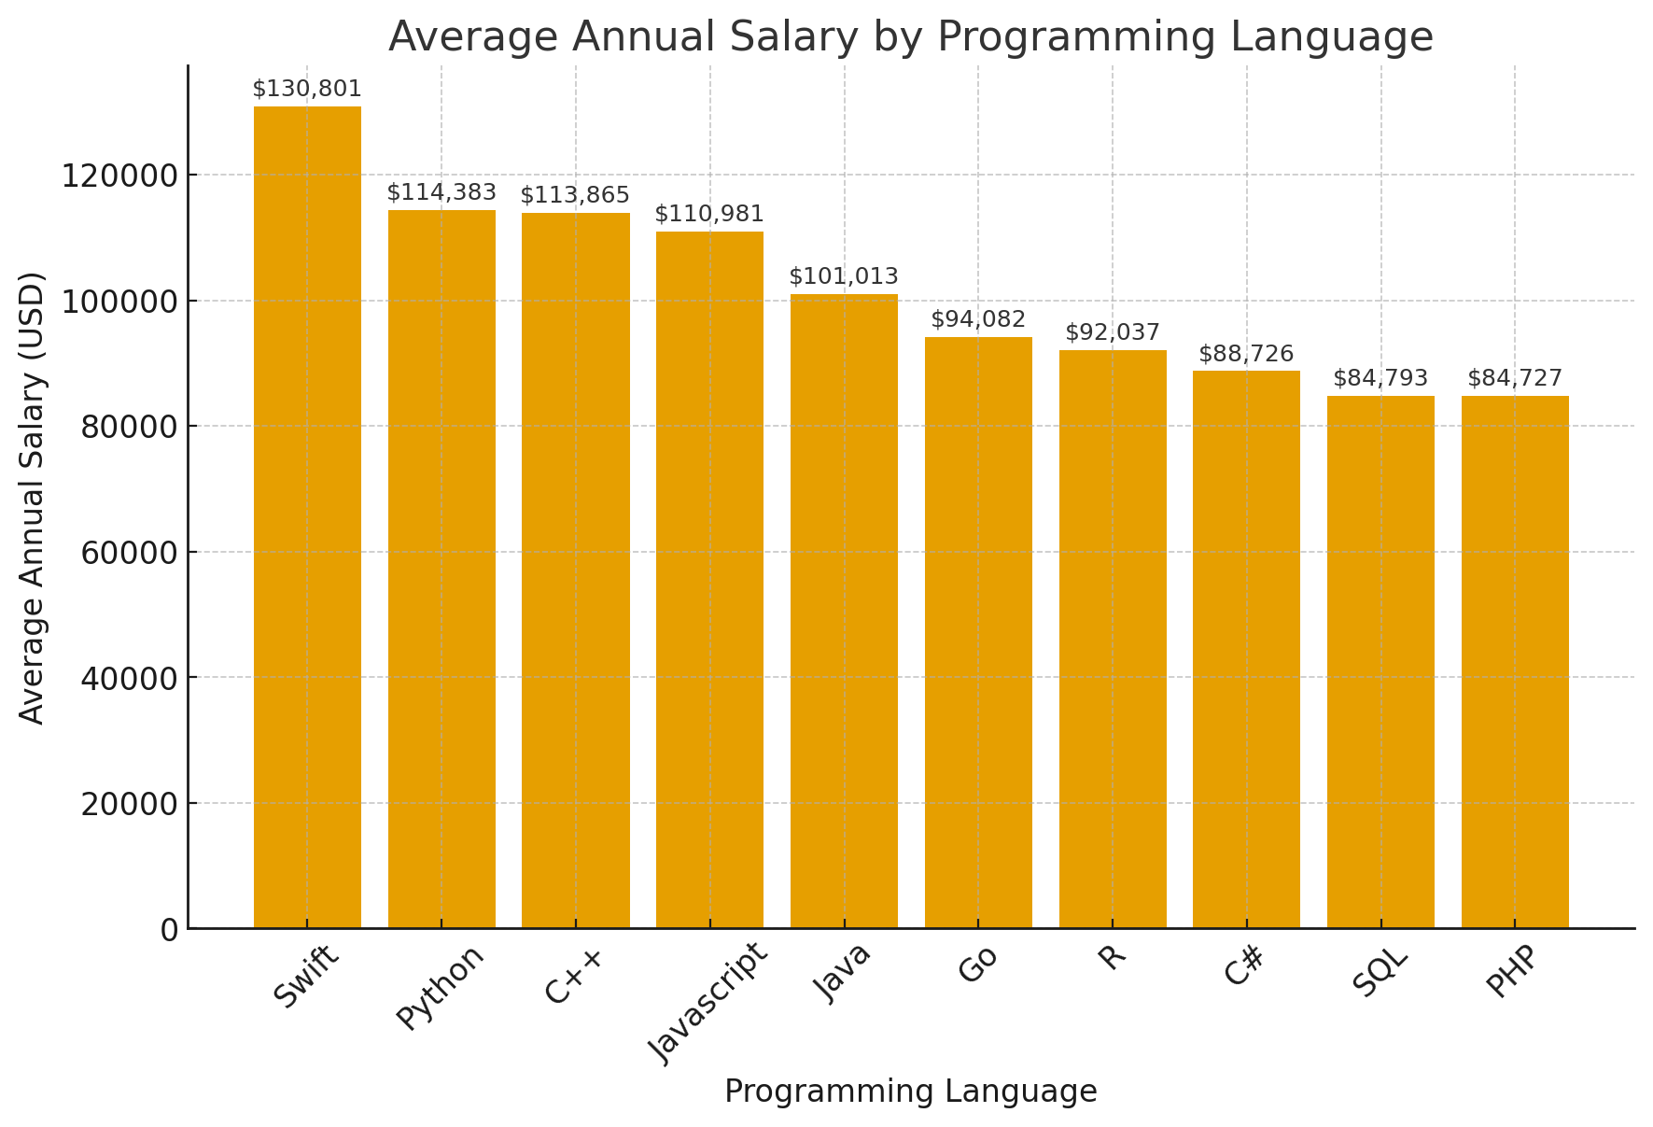
POPULAR LANGUAGES

